Slide 1
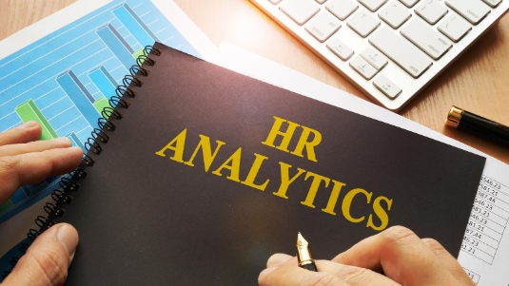


Slide 2

Welcome to the HR Analytics Project

Slide 3




Team Members
Mr. Chukwuyem
Business Analyst
Leader
Mr. Chile
Business Analyst
Asst. Leader
Mr. Obansere
Miss Shweta
Data Analyst
Data Analyst
Business Analysts (BAs): Focused on gathering requirements, developing user stories documentation and defining the HR KPIs needed for the dashboard, ensuring alignment with organizational objectives and stakeholder needs.
Data Analysts (DAs): Responsible for creating the SQL database from scratch, developing the HR dashboard in Power BI, and performing data analysis to generate insights that drive HR decisions.

Slide 4
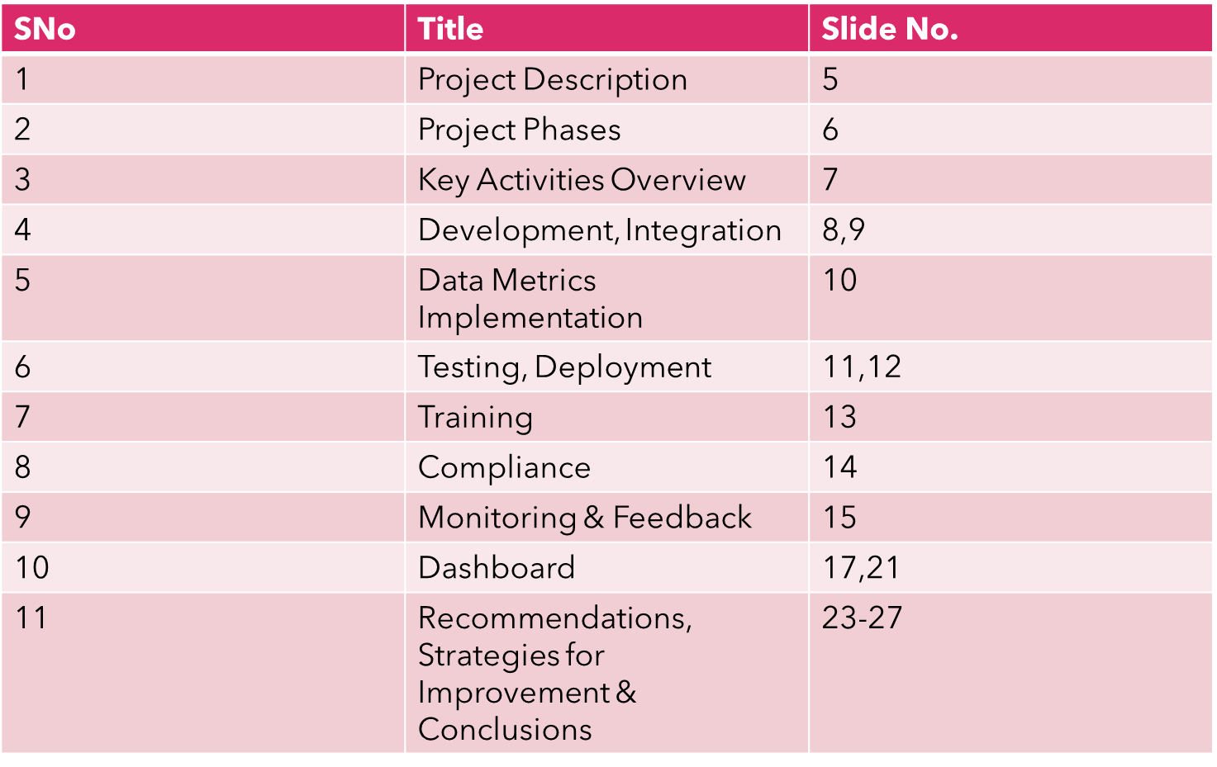

Table Of Contents

Slide 5

Project Description
Client X, an HR consulting firm, has partnered with StackwisR to develop a customizable HR dashboard for their clients. This dashboard will provide key insights into critical HR metrics, enabling data-driven decision-making.
Key HR Metrics Include:
Recruitment: Hiring and staffing efficiency
Productivity: Employee output and efficiency
Performance: Employee assessments and goal tracking
Remuneration: Compensation and benefits data
Finance: Financial impact of HR decisions
Objective:
To build a user-friendly, plug-and-play HR dashboard that Client X can easily customize for their clients’ needs.
Purpose:
To enhance decision-making by offering actionable insights across key HR metrics, improving HR processes and organizational performance for Client X and their clients.
Note: Due to GDPR and confidentiality reasons, the client's name has been replaced with 'Client X'.

Slide 6

Project Phases
Design: Crafting a user-friendly interface for the HR dashboard that allows intuitive navigation and interaction, tailored to the needs of HR professionals.
Development: Building the HR dashboard with robust functionality that supports plug-and-play features.
Integration: Ensuring the dashboard seamlessly aggregates data from various HR processes and systems, providing a consolidated view of key metrics.
Data Metrics Implementation: Incorporating functionalities to track and analyse specified HR metrics, including recruitment, productivity, performance, remuneration, and finance.
Testing: Conducting comprehensive testing to ensure reliability, accuracy, and user satisfaction with the dashboard.
Deployment: Implementing the dashboard in the client's environment, ensuring it is fully operational and accessible.
Training: Providing initial training sessions for client X to maximise their ability to utilise the dashboard effectively.
Compliance: Ensuring the dashboard adheres to data security and privacy regulations, protecting sensitive information.

Slide 7
Key Activities Overview
1. Gathered and elicited requirements from key stakeholders
2. Created initial designs, including use case diagrams, user stories, and acceptance criteria.
3. Utilised SQL to define and manipulate data to meet project requirements.
4. Created a variety of documentation, including the business analysis plan, stakeholder register, governance policy, risk register, business case, change management plan, scope document, and other relevant documentation.
5. Generated data from scratch and analysed it to meet stakeholder requirements.
6. Developed a dashboard with relevant KPIs to track HR performance.

Slide 8

Development
Features Based on Stakeholder Requirements:
The dashboard was developed to include several key features to meet stakeholder needs.
Key Performance Indicators Included:
Average Cost per Hire: Calculates the cost involved in hiring new employees, helping to manage and reduce recruitment expenses.
Days to Hire vs. Days to Fill: Tracks the time from candidate application to job offer acceptance versus the time from job posting to position filled.
Overtime vs Absent Hours: Analyses the relationship between overtime hours and absenteeism to optimise workforce management.
High Performers: Identifies and tracks high-performing employees
ROI (Return on Investment): Provides metrics to assess the financial impact and effectiveness of HR initiatives.

Slide 9
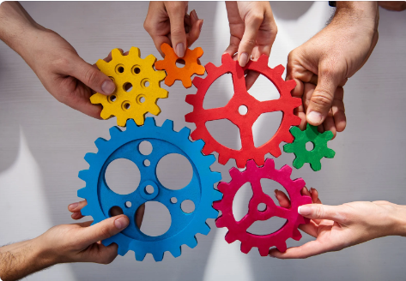
Integration
Data Aggregation:
Seamlessly integrated data from various HR processes and systems to provide a consolidated view of key metrics.
Streamlined Data Flow:
Ensured smooth data flow between different platforms, enabling real-time data updates and accurate analysis.
Technical Foundation:
Utilised SQL for data extraction and preparation, supporting seamless integration with Power BI for comprehensive analytics.
Power BI Integration:
Integrated the dashboard with Power BI to leverage its powerful data visualization and analytics capabilities.
Enhanced Data Accessibility:
Facilitated easy access to critical HR data, empowering stakeholders with the information needed for informed decision-making.
Consistent Data Presentation:
Maintained consistency in data presentation across different dashboards, ensuring clarity and usability.
T

Slide 10





Data Metrics Implementation
Recruitment:
Productivity:
Performance:
Developed dynamic visualisations to track the entire recruitment cycle, from job postings to time to hire.
Metrics Tracked: Average Cost per hire, Average number of days to hire, etc.
Created a module within the dashboard that represents employee productivity, using key performance indicators like average task completion time
Metrics Tracked: absence rate, absenteeism insights, overtime rate etc.
Designed an interface to visualise performance evaluations, goal achievements, and progress over time.
Metrics Tracked: performance management index, high performers, low performers, etc.
Remuneration:
Finance:
Incorporated data visualisations for salary distributions, and bonuses with comparative analysis features for internal benchmarking.
Metrics Tracked: Average rate per employee, Compa-ratio, etc.
Provided financial reporting specific to HR, such as payroll expenses, training costs, benefits payouts, and forecast return on investment for HR initiatives.
Metrics Tracked: assets by department, total cost breakdown, ROI by department ,etc.

Slide 11







Testing
Unit Testing:
Tested individual visuals for correct behaviour.
Integration Testing:
Ensured different parts of the dashboard worked together seamlessly.
System Testing:
Evaluated the complete and integrated system against specified requirements.
Performance Testing:
Assessed the dashboard's responsiveness and stability under various conditions.
User Acceptance Testing (UAT):
Conducted with actual end-users to confirm the system met their requirements and was ready for deployment.

Slide 12
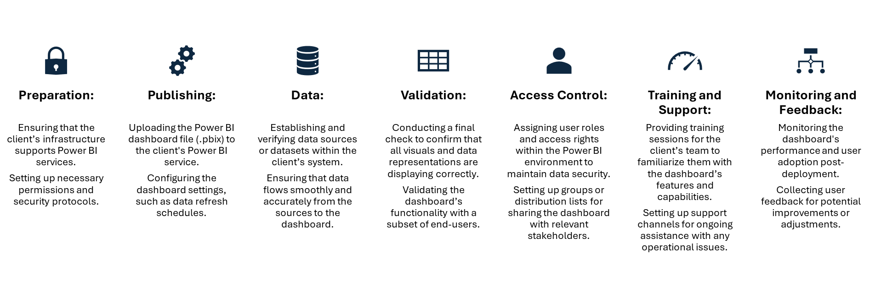
Deployment

Slide 13


Training
Training Sessions:
Conducted training sessions to familiarise users with the dashboard’s features and capabilities.
Provided hands-on demonstrations and tutorials to ensure users understood how to navigate and utilise the dashboard effectively.
Support Channels:
Established support channels to offer ongoing assistance with any operational issues or questions.
Provided resources such as user manuals, FAQs, and contact information for technical support.

Slide 14

Compliance
Data Handling Assurance:
All data used in this project has been handled in strict compliance with applicable laws and regulations.

Slide 15
Monitoring And Feedback
Monitoring the dashboard's performance and user adoption post-deployment.
01
Collecting user feedback for potential improvements or adjustments.
02

Slide 16

Dashboard

Slide 17
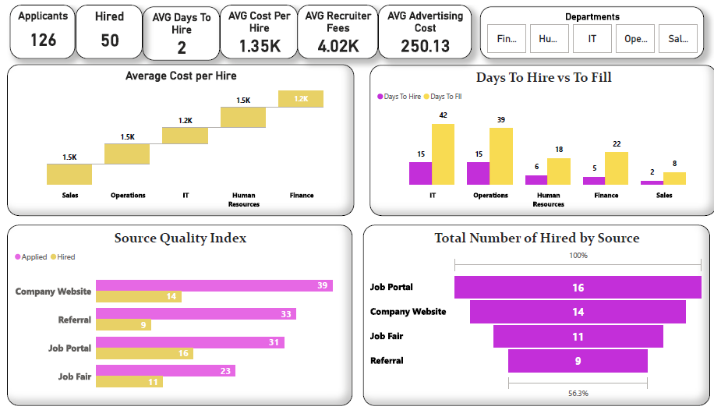
Recruitment

Slide 18
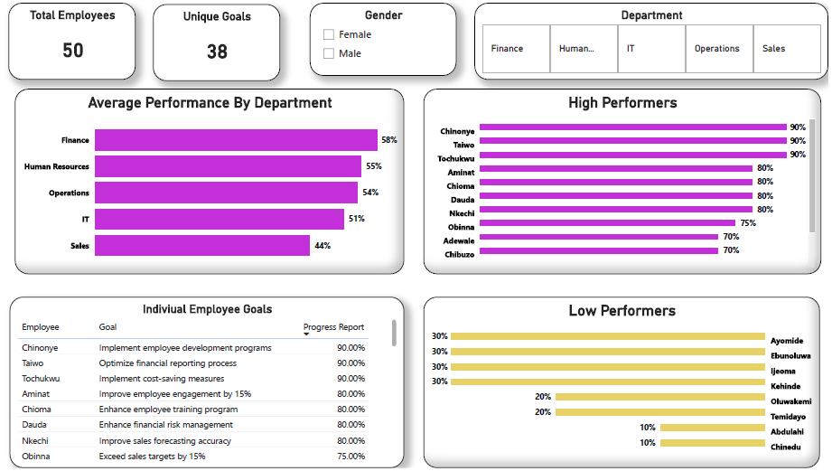
Performance

Slide 19
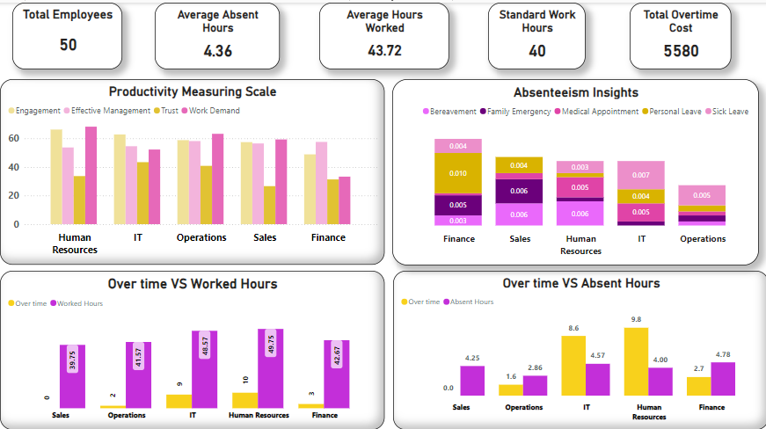
Productivity

Slide 20
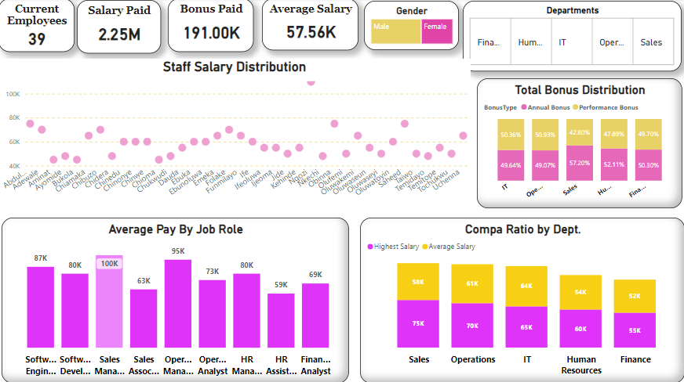
Remuneration

Slide 21
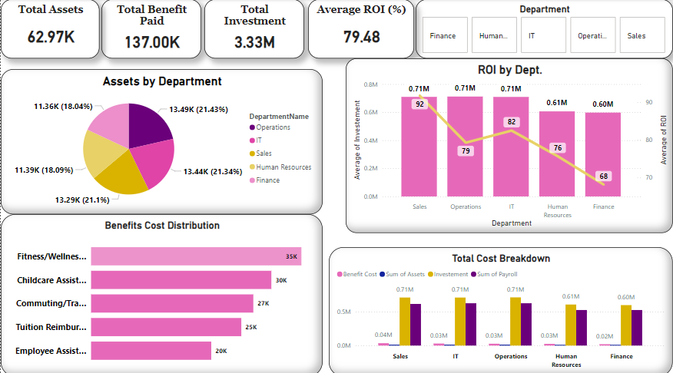
Finance

Slide 22


Slide 23
Recommendations
Regularly monitor the recruitment metrics displayed in the dashboard to identify hiring trends and optimise recruitment strategies. Use this data to adjust advertising spending, improve candidate sources, or refine the recruitment process.
Leverage real-time insights from the productivity metrics to proactively manage employee workloads and identify areas for improvement. This will allow HR to support work-life balance initiatives and reduce burnout risks.
Utilise the performance tracking capabilities to create tailored employee development plans and reward high performers. Regularly review performance data to align performance management strategies with business goals.
Analyse remuneration metrics to ensure compensation remains competitive and equitable across the organisation. This can help retain talent and foster employee satisfaction
Use financial metrics to allocate HR resources efficiently and measure the return on investment (ROI) for various HR initiatives. This will support cost-effective decision-making and long-term organizational growth.

Slide 24
Strategies for Improvement
Optimise Recruitment Strategies:
Enhance Job Portals: Increase investment in job portal advertising due to high conversion rates.
Revamp Company Website: Improve the careers section for better candidate engagement.
Leverage Job Fairs: Expand participation in job fairs for direct recruitment success.
Strengthen Referral Program: Offer incentives and training to boost employee referrals.
Enhance Employee Productivity:
Reduce Overtime: Implement workload management strategies in HR and IT to prevent burnout.
Offer Flexible Work Arrangements: Provide options for flexible working to improve work-life balance.
Introduce Employee Support Programs: Implement wellness and support programs to reduce absenteeism and enhance productivity.
Improve Performance Management:
Support Low Performers: Provide targeted training and support in the Sales department to improve performance.
Track and Improve Performance: Utilise performance tracking systems to identify and address issues promptly and recognise high performers.
Ensure Fair Compensation: Conduct regular reviews to ensure fairness in salary and bonus distribution, effectively motivating employees.

Slide 25



Strategies for Improvement
Remuneration
Remuneration
Remuneration
Remuneration
Finance
Remuneration
Investigate the $110k salary compared to the $40k - $60k range to ensure fairness and role alignment.
Assess the balance between annual and performance bonuses in departments, adjusting to improve satisfaction.
Address discrepancies, such as the Sales Manager’s higher salary, and ensure competitive compensation for all roles.
Review disparities between the highest and average salaries within departments for fairness.
Ensure that incentive programs are aligned with company objectives and effectively motivate performance.
Investigate the $110k salary compared to the $40k - $60k range to ensure fairness and role alignment.
Assess the balance between annual and performance bonuses in departments, adjusting to improve satisfaction.
Address discrepancies, such as the Sales Manager’s higher salary, and ensure competitive compensation for all roles.
Review disparities between the highest and average salaries within departments for fairness.
Ensure that incentive programs are aligned with company objectives and effectively motivate performance.
Investigate the $110k salary compared to the $40k - $60k range to ensure fairness and role alignment.
To ensure a fair bonus structure, align performance bonuses with specific department goals and set clear criteria for annual bonuses. Regularly review and adjust based on feedback and performance data to maintain balance and equity.
Evaluate significant pay gaps within similar job categories to ensure they are justified.
Review disparities between the highest and average salaries within departments for fairness.
Review asset distribution to ensure alignment with strategic priorities.
Investigate and improve factors contributing to lower ROI in HR and Finance.
Assess high costs of fitness/well-being benefits and consider reallocating if needed.
Justify investment and payroll expenses in departments with lower ROI and adjust, as necessary.
Regularly review payroll costs in Operations and IT to ensure efficiency and productivity.

Slide 26


Slide 27

Conclusions
1
2
1
2
We developed a comprehensive HR analytics dashboard for Client X Ltd., offering real-time insights into recruitment, productivity, performance, remuneration, and financial metrics, enabling data-driven decision-making.
3
By centralizing critical metrics in an intuitive, user-friendly interface, Client X Ltd. can now proactively monitor and optimize its HR processes, improving workforce management, employee engagement, and overall business performance.
The dashboard offers a scalable solution that can be further adapted to meet the unique needs of Client X Ltd. and its clients, supporting long-term growth and efficiency in HR operations.
The dashboard offers a scalable solution that can be further adapted to meet the unique needs of Client X Ltd. and its clients, supporting long-term growth and efficiency in HR operations.

Slide 28

Image Credits
This presentation uses images sourced from Canva Pro.
A special thanks to Canva for providing high-quality visuals.
All images are used in accordance with Canva's licensing terms.

Slide 29


